Slide 1
LAB 1
Manual Test Cases
By: Maleeha Khalid Khan

Slide 2
Test Case Idea
Test case is a document that contain a set of Test Data, Pre-conditions, Expected Results, Actual Results & Post Conditions
It defines The objectives, References, Prerequisites & Steps that a test case must follow
Preforming Test cases allows developers tin a business or developer organization to identify the defects within the software & make analysis to fix them

Slide 3
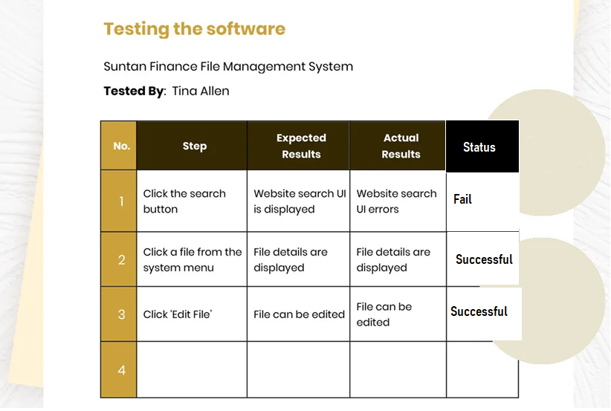

Slide 4
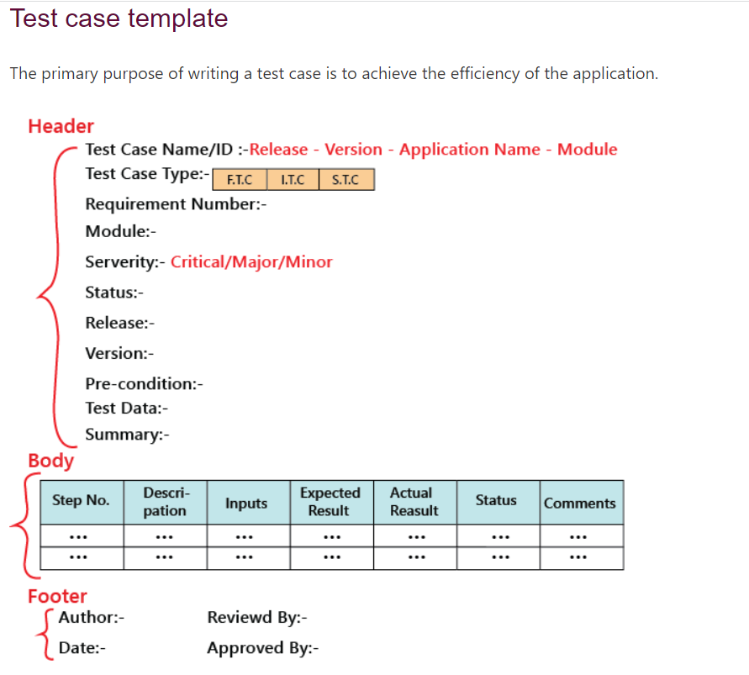
Template
Reference: https://www.javatpoint.com/test-case

Slide 5
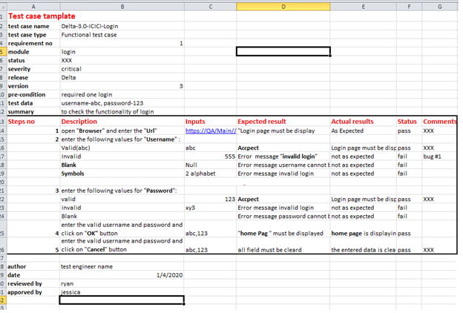

Slide 6
Task:
Scenario: User adds items to their shopping cart and proceeds to checkout.
What is initial condition
Steps
Expected Result

Slide 7
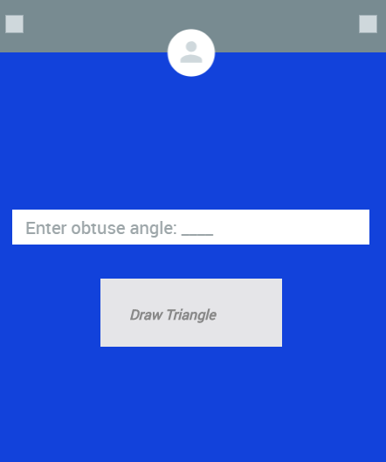
Exercise:
An obtuse-angled triangle is a triangle in which one of the interior angles measures more than 90° degrees. In an obtuse triangle, if one angle measures more than 90°, then the sum of the remaining two angles is less than 90°.
https://www.geogebra.org/m/szstvzha

Slide 8
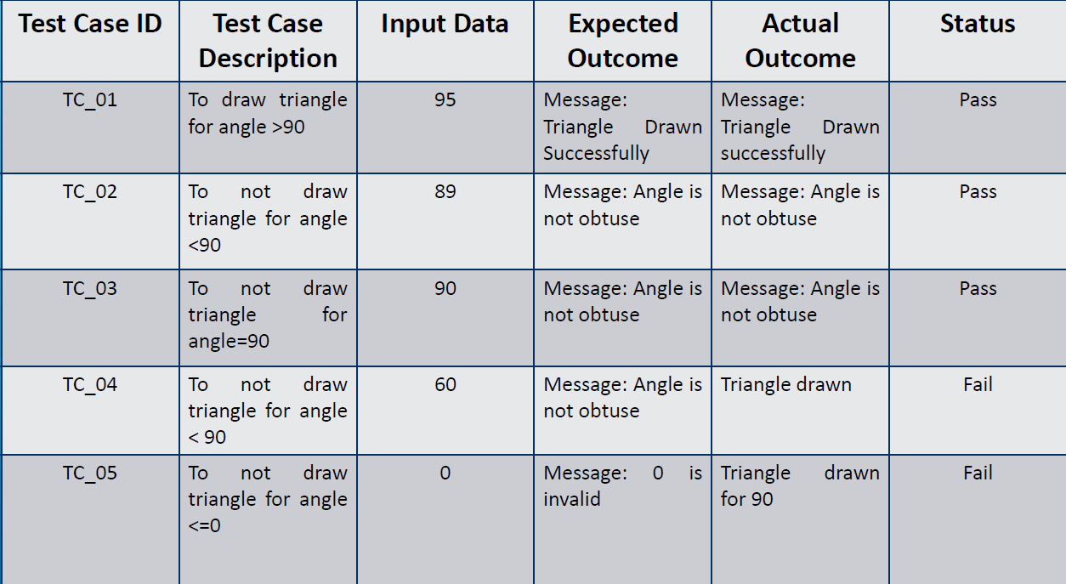

Slide 9
Break Problem:
First make test cases for 1 part where one angle must be more than 90
In Second focus on sum of 2 angles should be less than 90

Slide 10
Dummy Websites for testing
https://www.saucedemo.com/v1/
http://zero.webappsecurity.com/login.html

Slide 11
Make Test cases For following Scenario: FTC, ITC, STC
Make Test cases for this (http://zero.webappsecurity.com/login.html) website
Make Functional Test Case, Interface Test case, Security Test cases for following scenario
Functional Test Cases:
Check Login for valid user id
Check Login for valid user password
Check Login for Invalid user id
Check Login for Invalid user password
Check Login for blank user id
Check Login for blank user password
Check length for user id

Slide 12
UI Test Cases:
Check if the layout of the login is as per the specification.
Check if the placeholders are displaying properly or not.
Check if the * is displaying, which are mandatory fields.
Check that the checkbox, radio button, and text fields are as per the specification.
Check if the login page is responsive or not.

Slide 13
Security Test Cases
Check on click of the back button of the browser; the user should be logged out of the application.
Check whether a user can log in directly by entering the URL in the browser.
Check the login session timeout functionality.
Check whether the password field is encrypted or not.

Slide 14
Lab 2: How to Perform Static Analysis with manual efforts through test cases
Static Analysis:
• Examination of several documents, namely requirements documents, software models, design documents, and source code
• Static analysis includes code review, inspection, walk-through, algorithm analysis, and proof of correctness
• It does not involve actual execution of the code under development.

Slide 15
Task:
Make test cases for (http://zero.webappsecurity.com/login.html ) website , or for login make test cases for any random website
Write code for Obtuse Triangle & random member will review it
If it’s on paper, move it to the peer for static review
If it’s on compiler, hand it over to the peer

Slide 16
Task on Jupiter Notebook (Python Code) Review (Dry Run)
# Python3 program to sort letters
# of string alphabetically
def sortString(str):
return ''.join(sorted(str))
# Driver code
str = 'PYTHON'
print(sortString(str))
https://www.programiz.com/python-programming/online-compiler/

